Slide 1
Big Data Analytics
Homework 1: Hadoop setup and wordcount

Slide 2
Outline
Multi-work nodes Hadoop clusters
Introduction
Wordcount map-reduce program
Result
R program
wordcount
Result
Plot

Slide 3
Hadoop clusters-Introduction
Java version: 1.8.0_111
Hadoop version: 2.6.0
Clusters:
Master:NameNode & DataNode
Slave1:DataNode
Slave2:DataNode
Others:
Yarn:資源管理 & 任務調度
JobHistoryServer:管理過去工作的紀錄

Slide 4
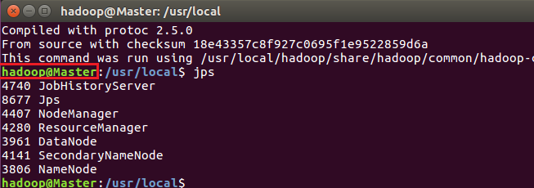
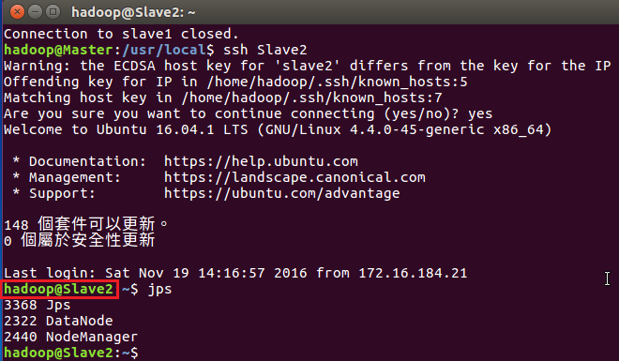
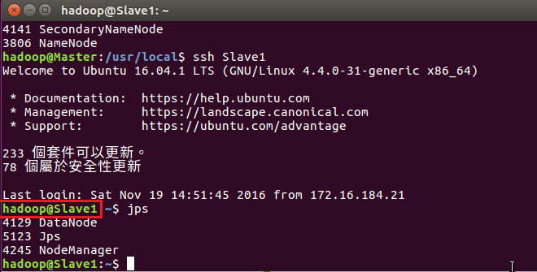

Slide 5
Wordcount map-reduce program
Wordcount.jar
temp.jar
Mapper.java
Reducer.java
Hadoop-common-2.6.0.jar
Hadoop-mapreduce-client-core-2.6.0.jar
Wordcount.java
Commons-cli-1.2.jar
Input:
Pg20417.txt
Pg5000.txt
Pg4300.txt

Slide 6
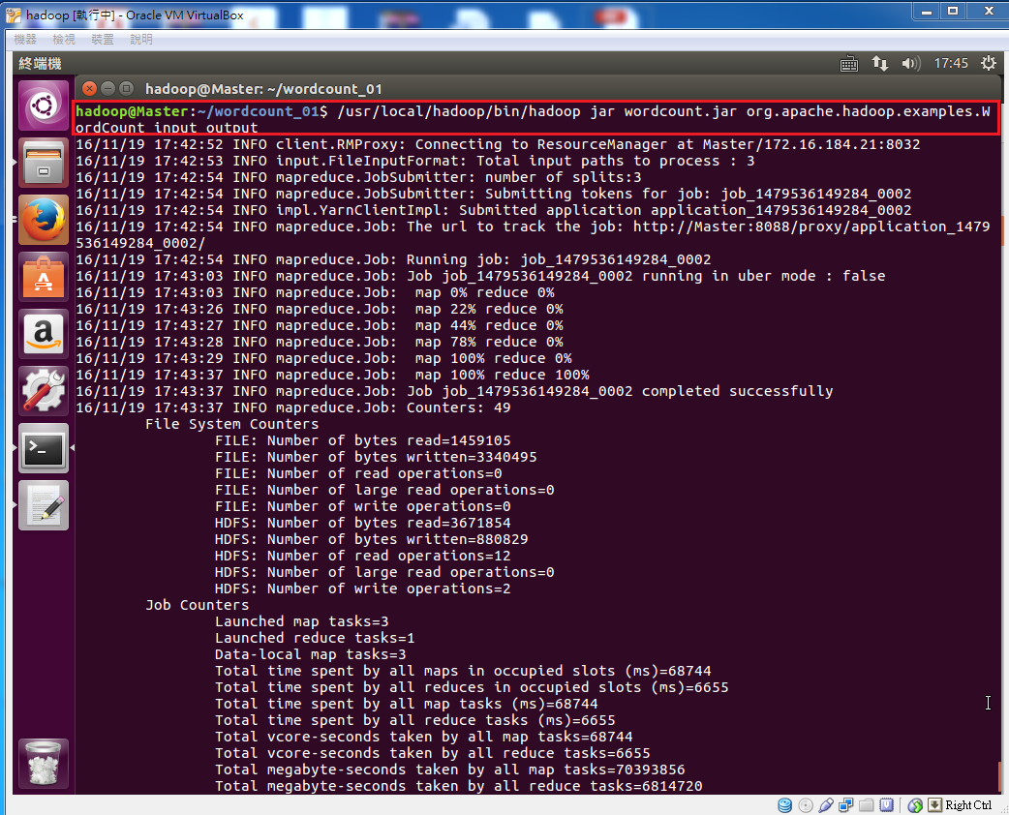
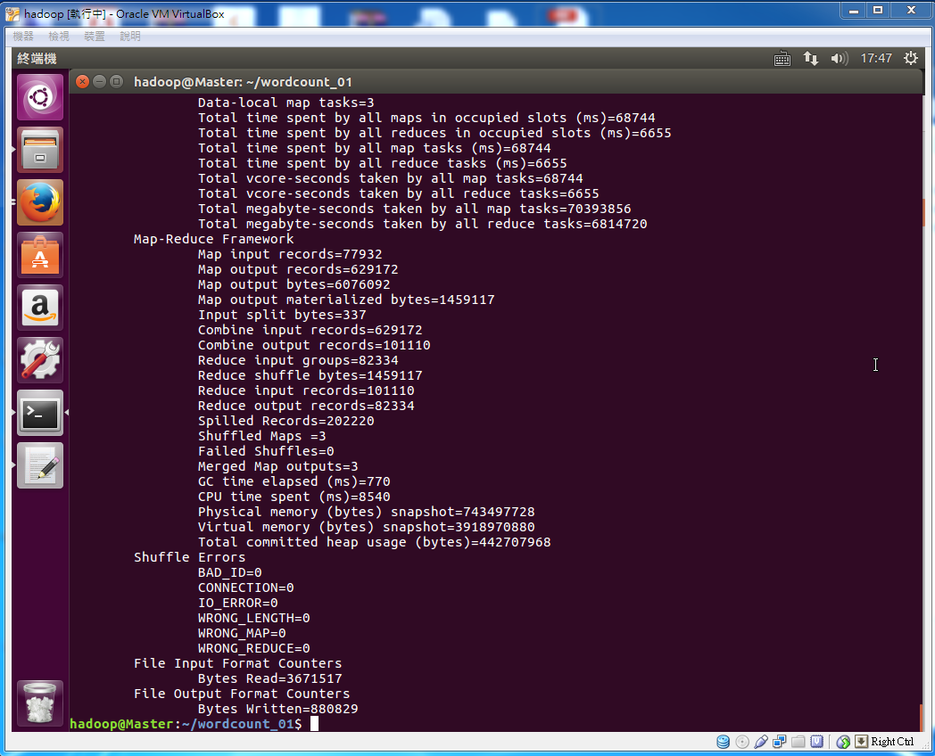
Multi-work nodes Hadoop clusters-result
Time:
17:42:52~17:43:37

Slide 7
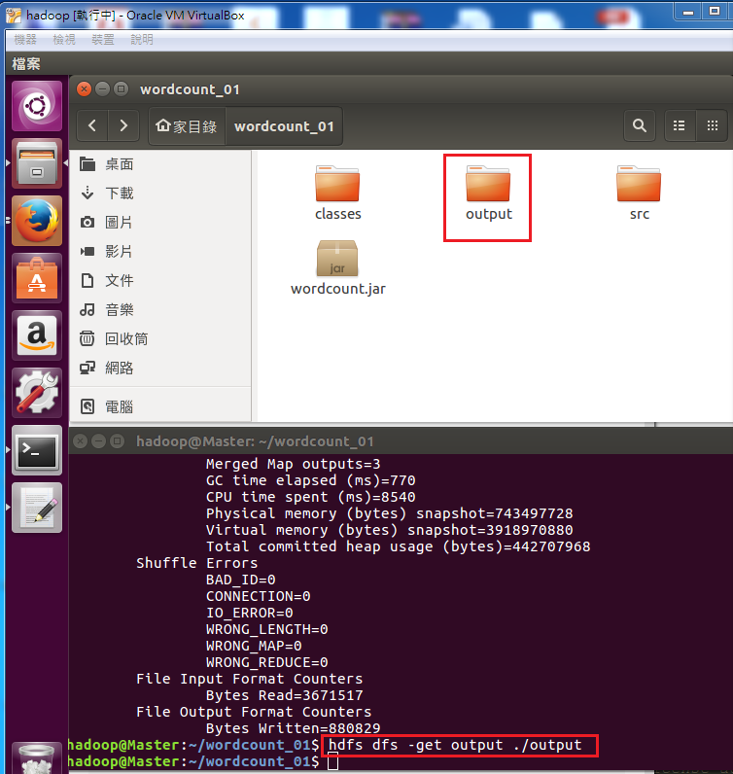
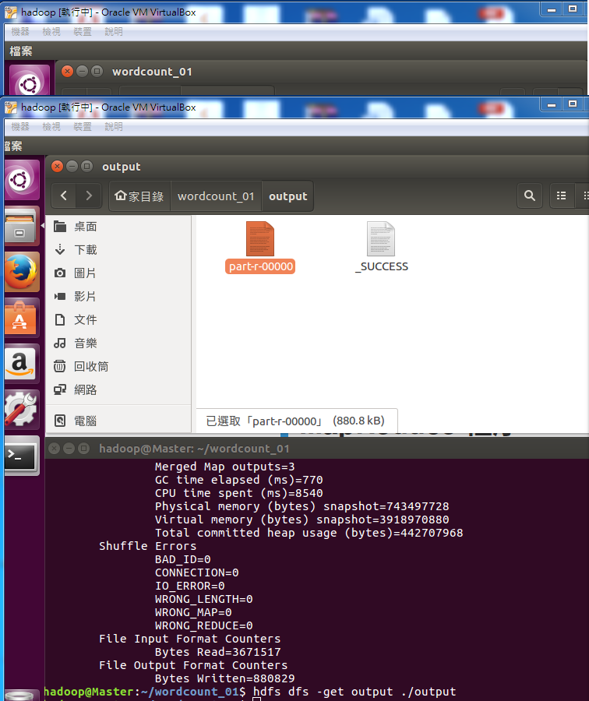
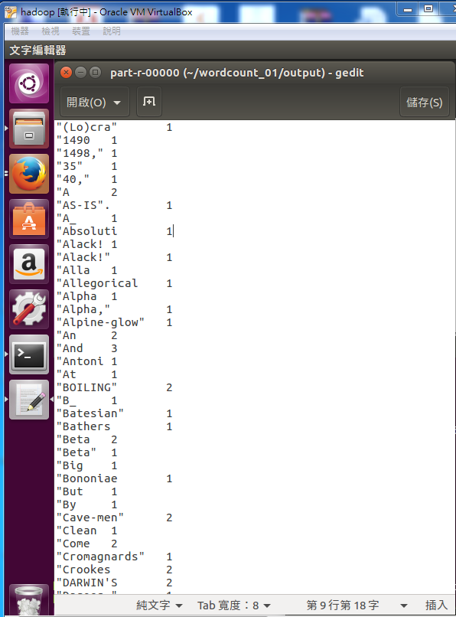
Multi-work nodes Hadoop clusters-result

Slide 8
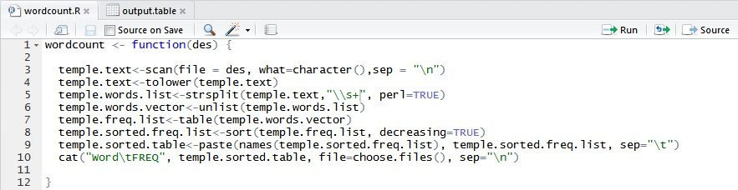
R program-wordcount
Tool : RStudio
Language : R
Input : all.txt (Include pg*.txt)

Slide 9
R program-Result
Word | FREQ | Word | FREQ | Word | FREQ | Word | FREQ | Word | FREQ
the | 46690 | on | 4788 | i | 3241 | will | 2047 | when | 1443
of | 24986 | he | 4417 | are | 3094 | but | 1928 | so | 1396
and | 18239 | his | 4244 | was | 3052 | their | 1760 |  | 1319
a | 13345 | as | 4175 | you | 2828 | her | 1742 | him | 1314
in | 12717 | by | 4043 | this | 2822 | an | 1646 | has | 1255
to | 12389 | which | 3719 | or | 2555 | we | 1599 | had | 1190
is | 7530 | for | 3653 | not | 2391 | one | 1583 | out | 1182
that | 6452 | be | 3586 | they | 2295 | if | 1570 | what | 1150
it | 5819 | from | 3347 | all | 2113 | its | 1566 | no | 1126
with | 4826 | at | 3261 | have | 2052 | there | 1545 | like | 1113

Slide 10
R program-Plot(1-1000)

Slide 11
R program-Plot(1-100)

Slide 12
Q & A

